Slide 1
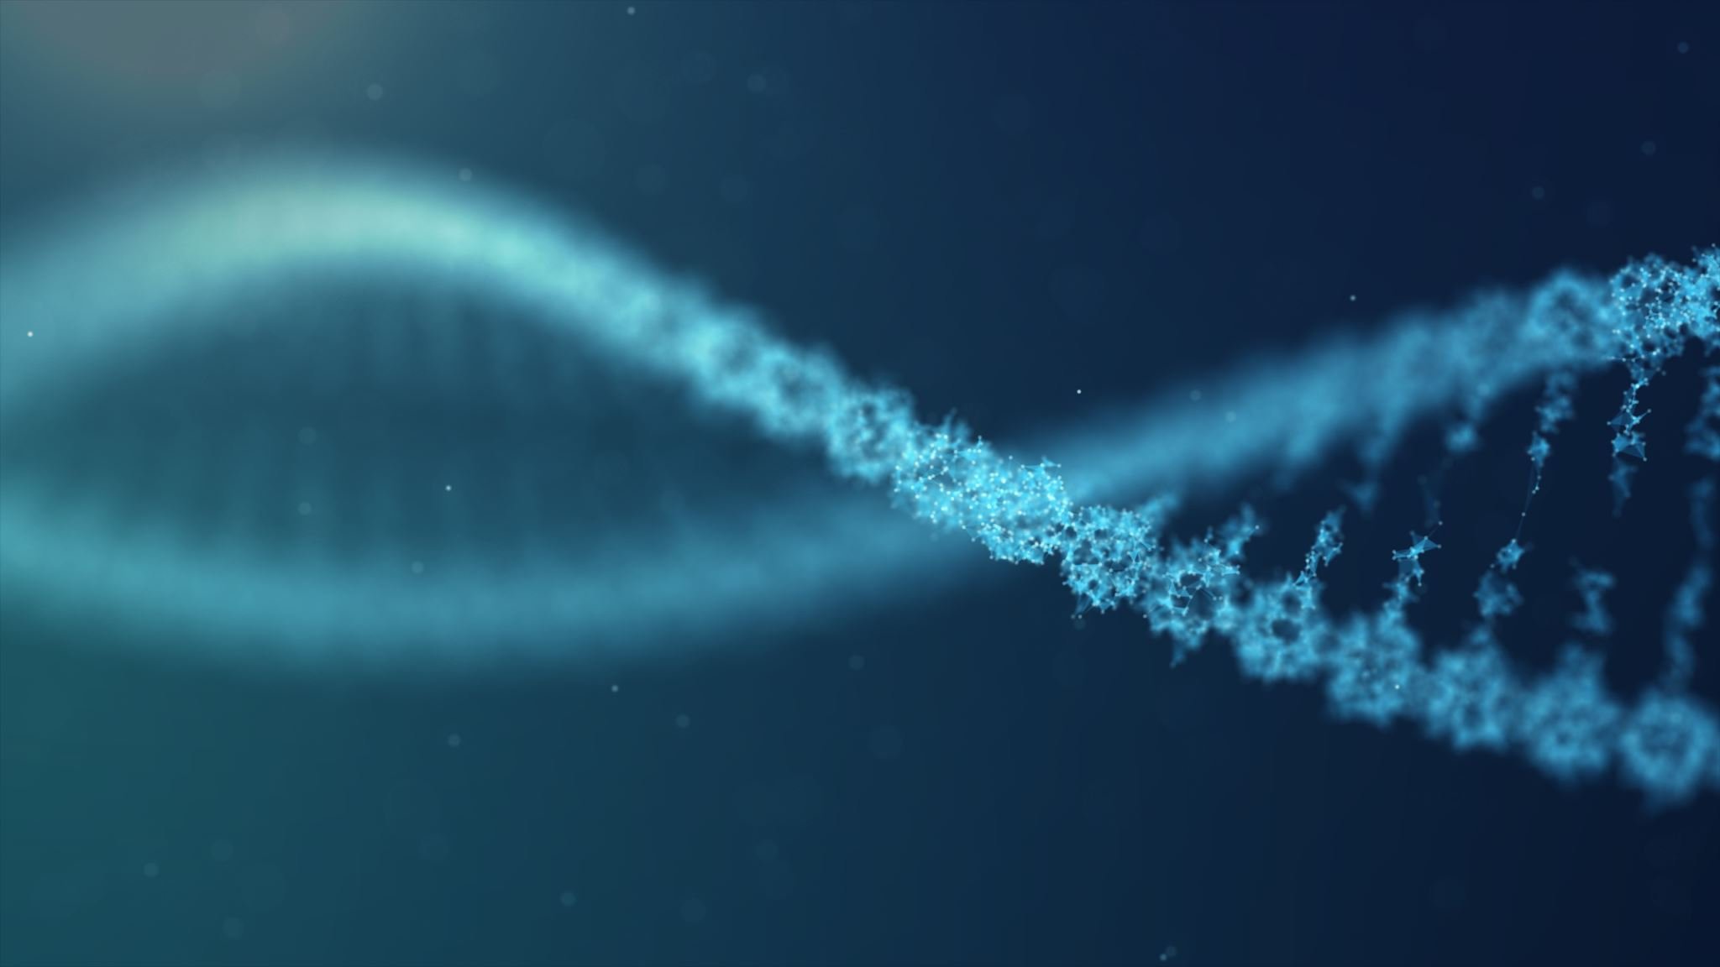
Studying the Genomic Variation in Haloferax Isolates from Atlit’s Tidal Pools
Alon Grossman
Supervisors: Dr. Neta Altman-Price, Prof. Uri Gophna.

Slide 2
Studied Organism: Halophilic Archaea
Three domains of life: Eukaryota, Bacteria, Archaea
Halophilic Archaea are obligate halophiles. They inhibit the most saline environments on earth- salt concentration can almost reach saturation.

Slide 3
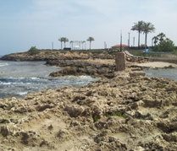
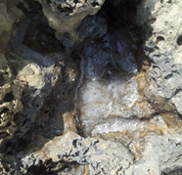
Habitat: Atlit’s tidal pools
Seawater pour or spray onto grooves in a rocky shore, constantly evaporating under the hot Israeli sun.
Water become saltier over time, even reaching saturation.
Hostile environment for most organisms, perfect for halophilic archaea.
From 2012 to 2018, various samples from the tidal pools were taken and cultivated every summer.

Slide 4
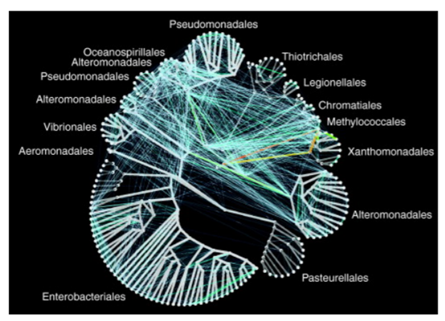
Cause of Interest: Speciation and Horizontal Gene Transfer (HGT) in Prokryotes
Multicellular Eukaryotes
Prokaryotes
Sexual reproduction
Specie= a group of organisms that can reproduce with one another to form a fertile offspring.
Speciation= the process of formation of a new species:the separation of one group of organisms from another to the point where they can no longer reproduce.
Binary fusion- definitions based on sexual reproduction no longer hold.
specie=?
Horizontal Gene Transfer (HGT) allows DNA sharing between distant, unrelated prokaryotes.
Speciation= ?

Slide 5
The Setup
Many prokaryotes in a small, competitive environment (salty tidal pool).
HGT is inevitable. Archaea can also undergo cell fusion, which might involve recombination.
Despite these, sequencing isolates from the tidal pools showed that no two cells were identical.

Slide 6
Project Objectives
In 2018, out of 100 isolates, 11 were identified as H. volcanii, and shared 99% ANI identity.
In this project, we aim to build and improve a bioinformatics system for the analysis of genomic variation between isolates originating from close niches.
We aim to examine specific regions of variation and determine the characteristics of this variety by analysis of the whole genomes vs analysis of specific genes unique for certain individuals.

Slide 7
Methods: Sequence Comparison
The goal: to investigate and characterize the differences between these highly similar isolates.
To obtain this, several tests and algorithms were used.
The results (not obtained by me) were verified manually, to improve the algorithms for later inspections.

Slide 8
Methods: Sequence Comparison
0. ANI analysis
Gene Prediction using MetaGeneMark (a tool for Genetic function prediction by sequence)
Assembling of predicted genes to homology groups: clusters. A group of ORFs is considered a “cluster” if all ORFs in it display a sequential identity of at least 75% percent and overlapping of at least 75% with an average sequence of this cluster.
Generating matrices from the clusters data (for sorting of the results).
Characterization of clusters’ biological functions using arCOG functions
Comparing of the clusters According to the number of species sharing them.
Summarization of all information in 11 tables, according to the number of isolates sharing each cluster

Slide 9
Expectations and focus
Core genes to be present in the all isolates (“only-in-11” table)
Unique ‘orphan’ genes to be present in the only-in-1 table
We did not know what to expect from the other tables, containing different ORFs from a ranging number of isolates not restricted by specific function.
This work focuses on these midterm tables, and especially tables number 2-8, as tables 9 and 10 were too large to be manually analyzed.

Slide 10
Example table
*not a full table
MERSRRQRQREQETEQTDDERLVCPECESSDIVTDADQGELVCDDCGLVLDEQQIDRGPEWRAFNHSERQSKSRVGAPITETMHDRGLTTTIDWKDKDAYGRSLSSEKRSQMHRLRKWQERIRTKDAGERNLQFALSEIDRMASALGVPRSVREVASVIYRRA
NODE_2_length_556072_cov_102.478942|gene_1078|113_aa|7349|7690|+, NODE_2_length_556072_cov_91.818961|gene_1078|113_aa|7349|7690|+, NODE_2_length_561135_cov_80.337015|gene_607|113_aa|7349|7690|+

Slide 11
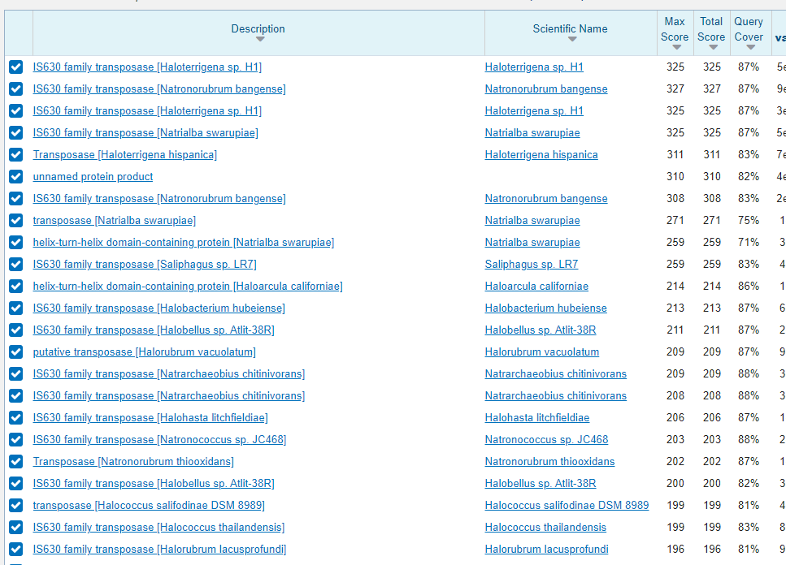
Tools for Manual ORFs Analysis: NCBI BLAST
Identification of clusters with no arCOG function or family
For example, a cluster found in 7 isolates. Analysis of the consensus sequence in BLAST determined its function as a transposase.

Slide 12
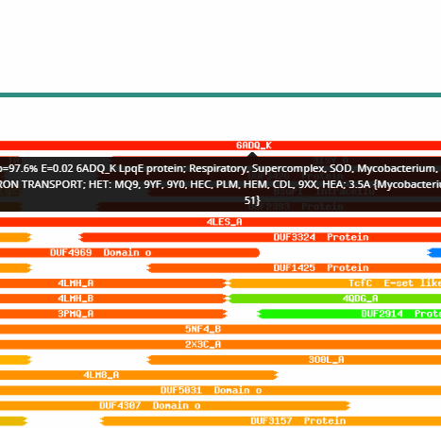
Tools for Manual ORFs Analysis: HHpred
detects homology and 3D structure similarity between distantly related proteins.
Differently from BLAST, HHpred assigns no significance for phylogenetic relationships, only to sequential and structural similarity.
Useful when methods such as arCOG and BLAST detect no similarity.

Slide 13
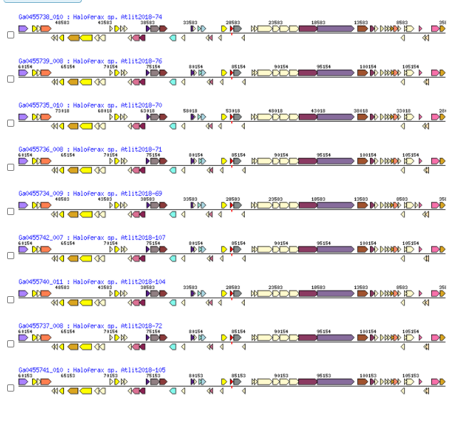
Tools for Manual ORFs Analysis: IMG
The Integrated Microbial Genomes (IMG) system of the Joined Genome Institute (JGI) serves as a community resource for analysis and annotation of genome and metagenome datasets in a comprehensive comparative context.
End-user level yet powerful analysis.
Gene neighborhood

Slide 14
Results: Code QA
Most clusters were not accurately analyzed: they were not actually shared between the number of isolates their respective table suggested.
Many of them were shared between all isolates.
For some of the clusters the consensus sequence was not found in any isolates.
Most Tables were cleared out.
Table two retained most of its clusters.

Slide 15
Causes of false clustering
Alignment inaccuracies (no proper alignment was perfomed during clustering).
Motive inaccuracies (different proteins with some shared motives classified together under one cluster)
Edge of sequences problems (cut sequences might damage clustering by becoming the shortest reference in cluster.
Homologs inaccuracies (different ORFs in the same isolate clustering together.
Artifacts (clusters with consensus sequences too short to be considered an actual ORF)

Slide 16
Suggestions for improvement of the code
Adding alignment as an obligatory requirement for clustering.
Checking for homologous copies of an ORF inside isolate. Indicating any case of copes in the tables.
Characterize close-motives proteins, separating them to different clusters while keeping an indication for their connection.
Full genome assembly before analysis can fix the peorblem of contig edges.
Taking BLAST and HHred into account when determining the function of an ORF.

Slide 17
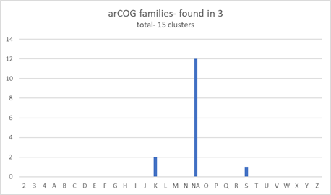
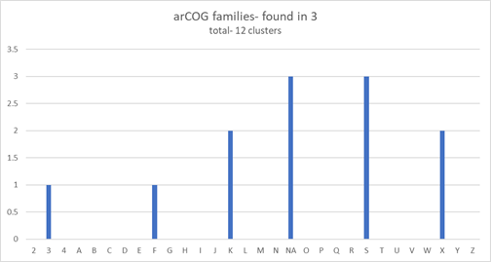
Results: Genetics Variance
Defining new arCOG functions and families for NA and uncharacterized matches

Slide 18
Results: Isolates 106 & 108
Isolates 106 and 108 were found to be more similar to one another then to all other isolates.
They share specific genes with one another that no other isolates have had. More than 70% of clusters in the table “found in 2” were clusters shared only between 106 and 108
They also lack specific genes that all other isolates do possess. More than 92% of clusters in the reciprocal table – “found in 9”- were found in all isolates but 106 & 108.
Perhaps, these isolates contain a plasmid incompatible with a plsmid present in all other isolates.

Slide 19
Results: Cluster Coupling
Some clusters prevalent in the same number of isolates were “coupled”- they always appeared together, in the same isolates, same contigs, with close gene numbers.

Slide 20
Viral infection
HHpred Analysis of the clusters in green indicated an RNA polymerase and a norovirus capsid.
These clusters are separated by another cluster, which was not in the table. HHpred resulted in a 99.97% match to INTEGRASE; HYDROLASE, SERINE RECOMBINASE, UNIDIRECTIONAL, SITE-SPECIFIC RECOMBINATION of viral origin.
This indicates a shared viral origin for this group of clusters.
Close examination revealed that this group appeared only in 3 different sites in the genome (even though it present in 6 isolates), suggesting site specific infection and, possibly, traces of recombination or more than one infection.

Slide 21
Contribution of mobile elements to the genetic variance
The most prevalent arCOG family among the different clusters was family X- Mobilome (prophages, transposons)
Mobile elements are perfect candidates to contribute to genetic variance in a small population: they can jump along the genome, infect new areas in it and move between organisms in all sorts of mechanisms.
What made them stop? what prevented them from infecting all of the isolates in the small shallow pools?

Slide 22
Why might infection be limited?
Perhaps most of the mobile genetic elements have lost functionality a long time ago.
It might be that some isolates have a complementary sequence for several mobile elements in their CRISPR system.
Might be both.

